Slide 1

The Vicious Vikings

Slide 2
When did the Vikings come to Britain?
The Vikings first invaded Britain over one thousand years ago. In 793 there was a Viking raid on Linisfarne in Northumbria. The word Viking means pirate raid.

Slide 3
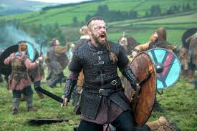

Slide 4
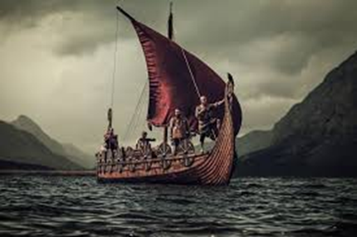

Slide 5
Who were the Vikings?
The Vikings were ruthless raiders who left their own countries to find land elsewhere.

