Slide 1
VIKINGS
RUTHLESS WARRIORS

Slide 2
WHO WERE THE VIKINGS ?
The Vikings were fearsome warriors who didn’t let anything stand in their way . The Vikings are also known as Norse people from Scandinavia . Scandinavia is made up of three countries , Sweden , Norway and Denmark . The Vikings are sometimes thought of wearing helmets with horns on but Vikings never ever had horns on their helmets there’s something to tell your mates . Did you know the word Viking means pirate raid ?

Slide 3
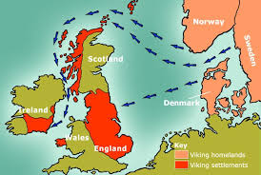
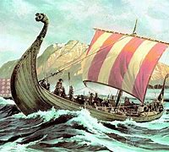
When were the Vikings in Britain ?
These demolishing warriors left there home countries and sailed to Britain in 793AD , to sail that far as you might of expected these combatants were fantastic craftsmen and women they can build sturdy boats that can sail through huge storms and rough seas . These fighters came from three different directions the Vikings from Norway went over to Ireland the people that came from Sweden went to Scotland and the Vikings from Denmark went to England

Slide 4
HOW DID THEY GET TO BRITAIN ?
As you know the Vikings came from Scandinavia to Britain but how did they get there ? The Vikings sailed on these massive ships called longships . They were built to survive and last dangerous storms . These ships were incredibly successful . The Vikings went undefeatable and ruled their own bits of Britain and raided others until 1066AD when they were on a raid but were usured by the Normans who later on ruled Britain .

Slide 5
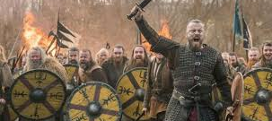
Here are some pictures of these vicious Vikings

Slide 6
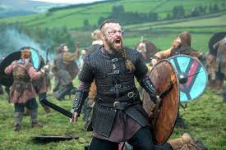

Slide 7
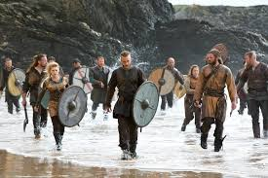

Slide 8
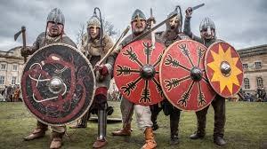
THANKS FOR WATCHING !

