Slide 1
The Vicious Vikings
By I h

Slide 2
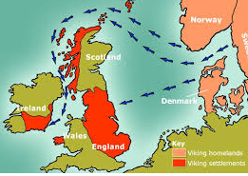
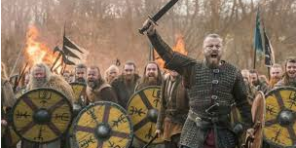
Where and when did The Vikings invade Britain ?
In 793 AD some vicious Vikings decided to go to Britain to get more land. It was believed that all the rich men had all the wives so the single men (who didn’t have wives to worry about) wanted to find some land and make a new start in a different country.

Slide 3
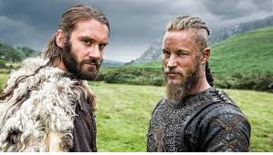
Who were the Vikings?
The Vikings were from different places such as Norway, Sweden and Denmark. The went on to settle in other areas of the golde including Scotland and England.

Slide 4
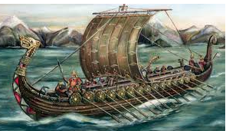
How did the Vikings get here?
These wonderful warriors weren’t just fighters - they were boat builders. They were really good at building boats so they sailed across the seven seas.

Slide 5



Thanks for watching☺☺☺!!!!!!!!!!!!!!!

