Slide 1
THE VICIOUS VIKINGS
By Jacob

Slide 2
WHO WERE THE VIKINGS?
The Vikings were pirate raider who would explore islands for gold or souvenirs to impress their girlfriends. The Vikings would occasionally meet together to make new rules. If you were a Viking and you were poor you wouldn’t get any girlfriends. If you were the youngest brother you wouldn’t inherit anything but your older brother or sister would get all the land and all the money. The poor people would do farming and wear old, rugged clothes. So they left their countries to find land and riches in another country.

Slide 3
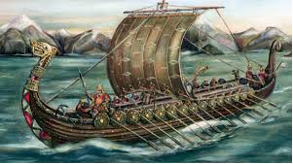
WHERE DID THE VIKINGS COME FROM?
The Vikings started were a group of Norse people. Some Vikings went to explore islands and try get gold or silver. The Vikings in Denmark attacked Wales and the Vikings in Sweden would attack Scotland then that left Norway who attacked Ireland.

Slide 4
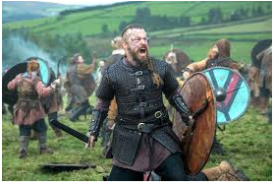
WHEN THE VIKINGS WERE IN BRITAIN
The Vikings came to Britain in 793 AD. The Vikings came by boat In 1066 they got into a big battle at Stamford Bridge with the Normans and this is what it probably looked like.
FACTS
Harold did not get shot
In the head with an arrow
He actually got killed by 3
Normans.

Slide 5
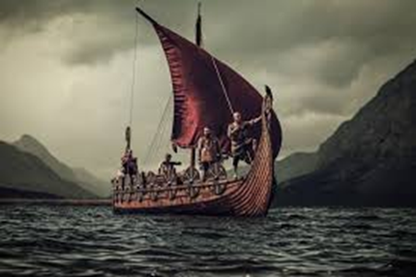
HOW THEY GOT TO BRITAIN
They got to Britain by using long ships that were made out of wood and shields around the edge. Traditionally they are shown with a sail that was red or white . This is an example of one their ships as you can see there is a man pulling the sail with rope so that the
Ship could turn around.

Slide 6


Thank you for watching

