Slide 1
The Vikings
By P.E

Slide 2
Who were the Vikings?
The Vikings were from three countries Sweden , Norway and Denmark. They where ruthless explores because Viking meant pirate raid. They also wanted to invade England.

Slide 3
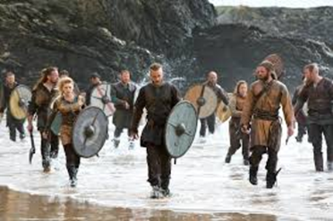
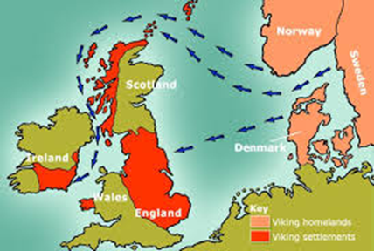

Slide 4
When were the Vikings in Britain?
The Vikings were in Britain over a 1ooo years a go. They were there because of several reasons. Not only did they come here for a reason they came here to get land from other people. WHY?!! Because the older sibling got the land and riches when there parents died. They also came here to start a new life.

Slide 5
Where did they come from?
The Vikings came from Sweden , Norway and Denmark. Which all together makes Scandinavia. A place where they were unhappy and upset.

Slide 6
How did they get to Britain?

