Slide 1
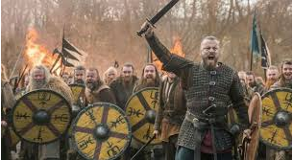
Angry explorers

Slide 2
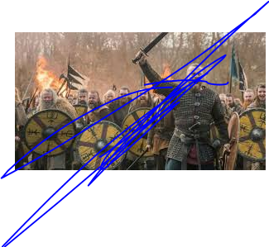
Who were the Vikings?
The Vikings were ruthless explorers which means they never gave up.
Did you know?
Viking means pirate raid.

Slide 3
When were the Vikings in Britain?
The Vikings were in Britain in 793AD to 1066AD

Slide 4
Where did the Vikings come from?
The Vikings
came from Scandinavia
to Britain.

Slide 5
How did they get to Britain?
They got to Britain by a longships they made.
They went from Norway to Scotland.

