Slide 1
The Vikings
By Sam

Slide 2
Who Were the Vikings?
The Vikings were ruthless explorers that came to England to take land.
Did you know that the word Viking means pirate raid?

Slide 3
When were the Vikings in Britain?
The Vikings came to England in 793ad and were defeated in 1066ad at the Battle of Stamford Bridge.

Slide 4
Where did they come from?
The Vikings came from Scandinavia which is know known as Sweden, Norway and Denmark.

Slide 5
How did they get to Britain?
They went from Norway to Scotland on boat. It took several days to get there.

Slide 6
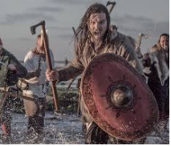
Thanks for watching!!!

