Slide 1
VIKINGS
ANGRY WARRIORS

Slide 2
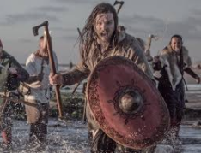
WHO WERE THE VIKINGS?
Their name means pirate raiders and they were ruthless explorers. They travelled to Britain to have war against the British people.

Slide 3
WHEN WERE THE VIKINGS IN BRITAIN?
The Vikings were in Britain at around 793 AD to 1066 AD in Great Britain.

Slide 4
WHERE DID THEY COME FROM AND HOW DID THEY GET THERE?
They came from Scandinavia (which is Sweden, Denmark, Norway) and they travelled in Viking longships.

Slide 5
DID YOU KNOW ?
Only rich men had wives no poor men did have them, only rich men.

Slide 6
THANKS FOR WATCHING !

