Slide 1
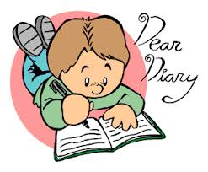
Diary Writing

Slide 2
What is a diary?
A piece of writing that tells us about what you were doing or feeling at a certain time.
It is a way to record your thoughts.

Slide 3
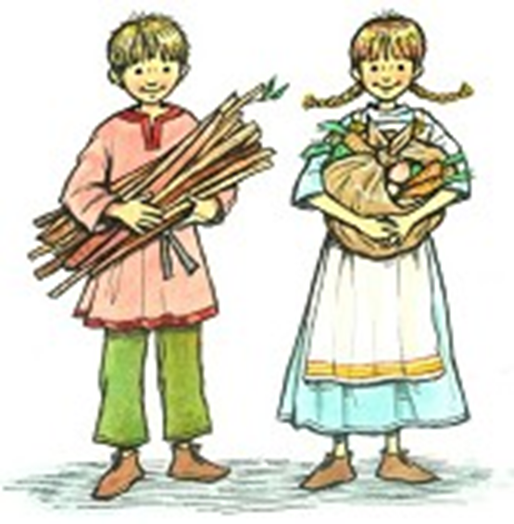
Imagine you are a child in Viking times…

Slide 4
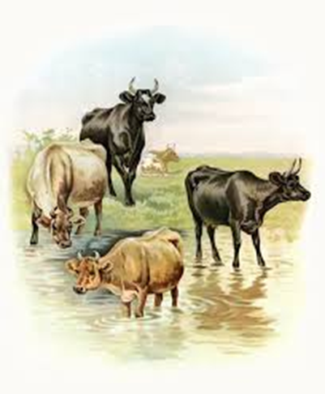

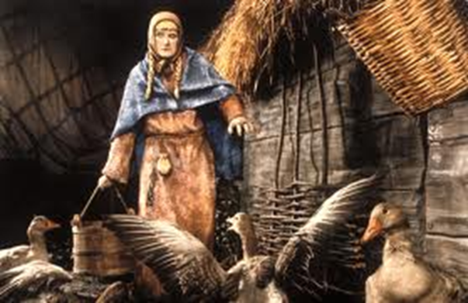
You work hard every day!
You wake up really early in the morning to feed the animals and help your parents to milk the cows and collect eggs from the chickens.

Slide 5
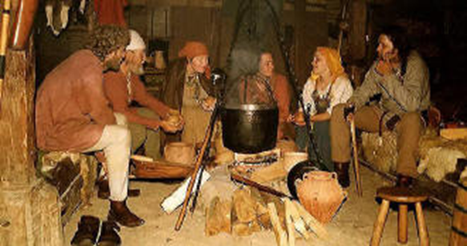
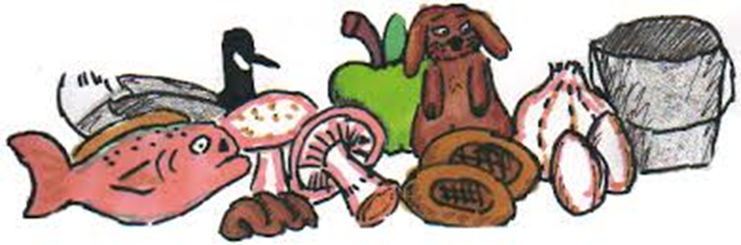
You only eat two meals a day
Everything you eat you make from scratch or kill it yourself.

Slide 6
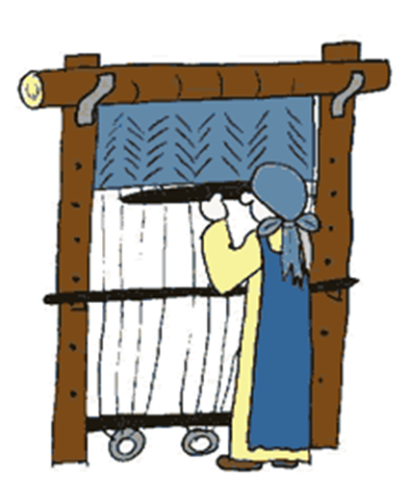
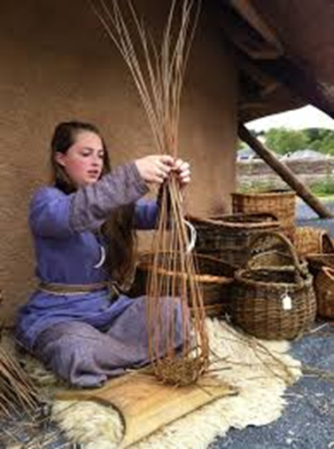
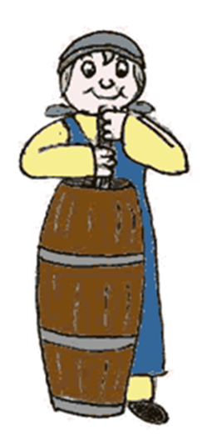
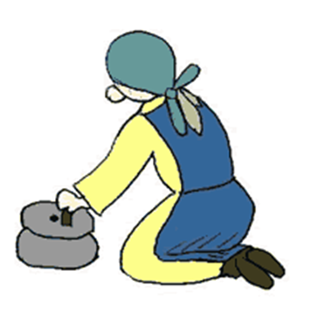
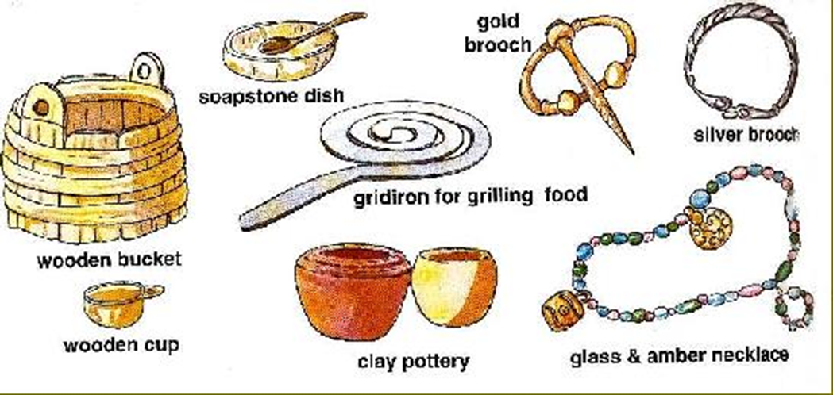
You work hard all day long

Slide 7
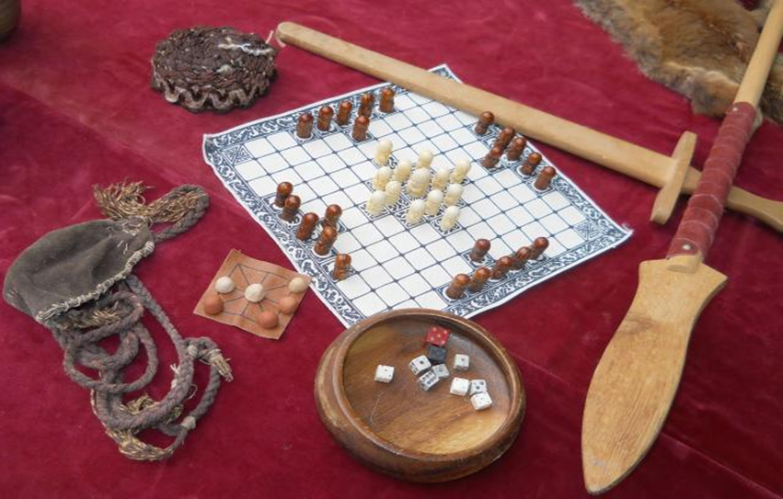
Not much time for play
But when you’ve finished your work..
Or listen to stories about history and religion.

Slide 8
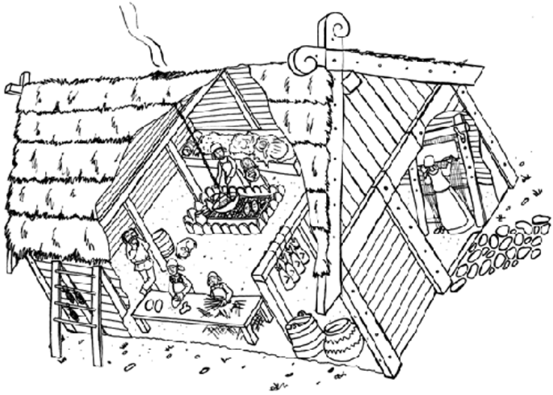
You live in a longhouse

Slide 9
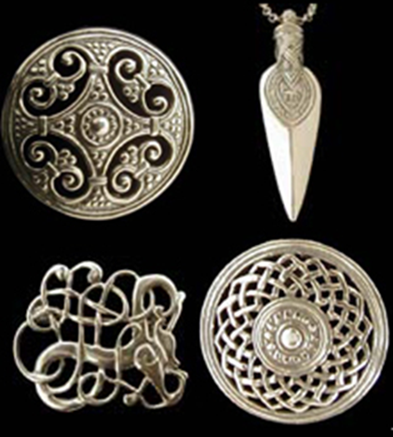
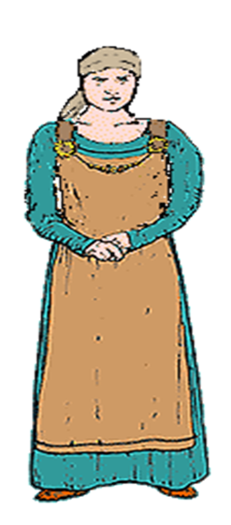
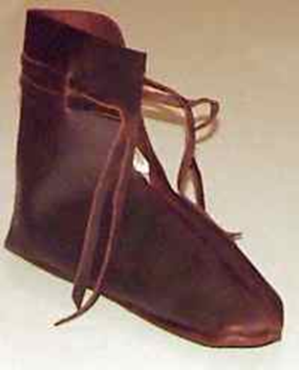
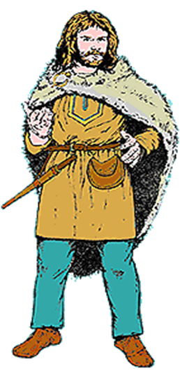
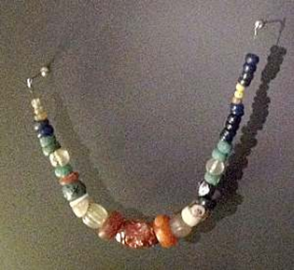
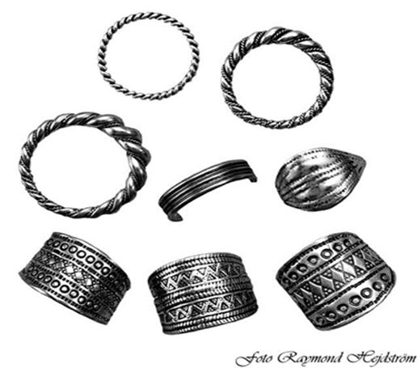
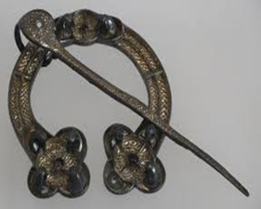
You wore

Slide 10
Write a diary entry about your day.
What you did in the morning.
What you did in the middle of the day.
What you did in the evening (after work).

Slide 11
You should say..
What you have been doing.
This morning I have been working hard helping mom to feed the chickens.
How you are feeling.
I am happy today because I practiced my fighting with my cousin. I am getting really good.
I am tired, I worked hard all day weaving baskets.

Slide 12
You should use.
‘I’ , ‘we’ : You are talking about yourself.
Verbs: Walked, worked, jumped, fought, ate, slept.
Examples of events that happened during your day.
Remember you are pretending to be a Viking child!

Slide 13
Dear diary,
As usual this morning, I woke up at 6 o’clock. My first job was to help mum feed the chickens then we worked in the vegetable garden. We worked hard for two hours so I was very grateful to eat the porridge mum made on the fire. It was delicious!
This afternoon, I spent my time making a new dress for my mother - I hope she likes it. My hands were very tired afterwards but then I had to help my auntie to weave some baskets. There’s always something to be done.
After a busy day, I am now getting ready to go to sleep. Dinner was delicious - wild boar and cabbage. Luckily, dad and my brother had killed a wild boar when they were out hunting yesterday so we’ll eat like gods for the next few days. It was great to have a lovely full tummy. I then played ‘Kingy bats’ with my brother. I beat him! Haha!
I’m laying on the sheepskin blanket that I made whilst Dad uncle tell stories about Thor beside the fire. The wind may be whistling outside but it’s so cosy here by the fire. Goodnight.

