Slide 1
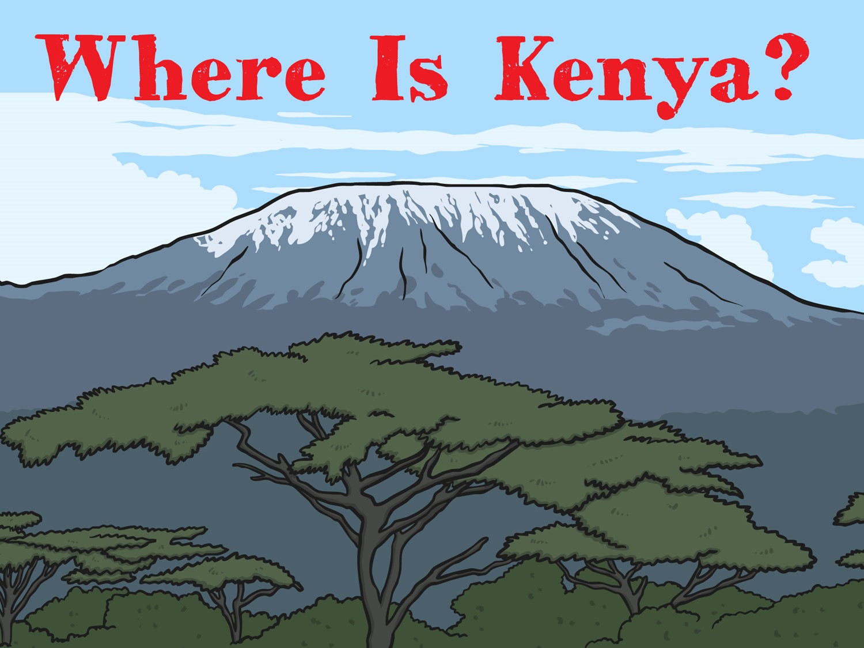

Slide 2
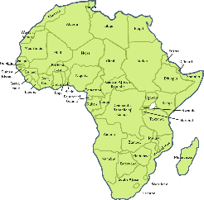
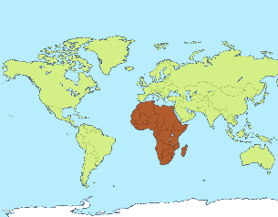
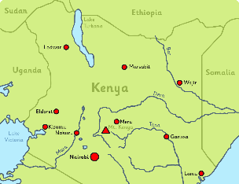

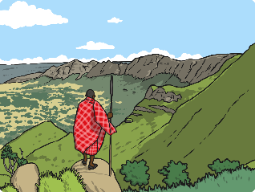
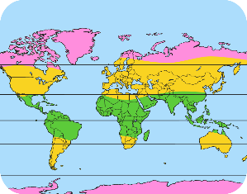
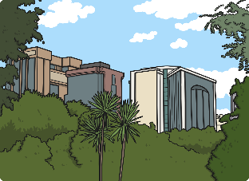
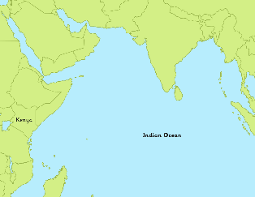
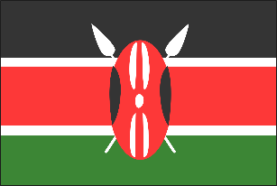
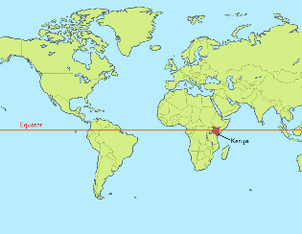
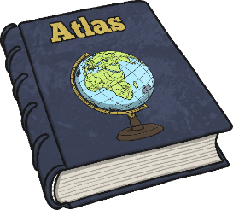
Key Words
Africa
continent
country
capital city
Kenya
weather and climate
Nairobi
Indian Ocean
flag
equator
atlas

Slide 3

What Do I Know Already?
Quick Quiz!
Which continent is Kenya in?
1
Can you write any 2 things you know about Africa?
2
What do you think the climate/weather is like in Kenya?
3
What animals do you think live in Kenya?
4

Slide 4
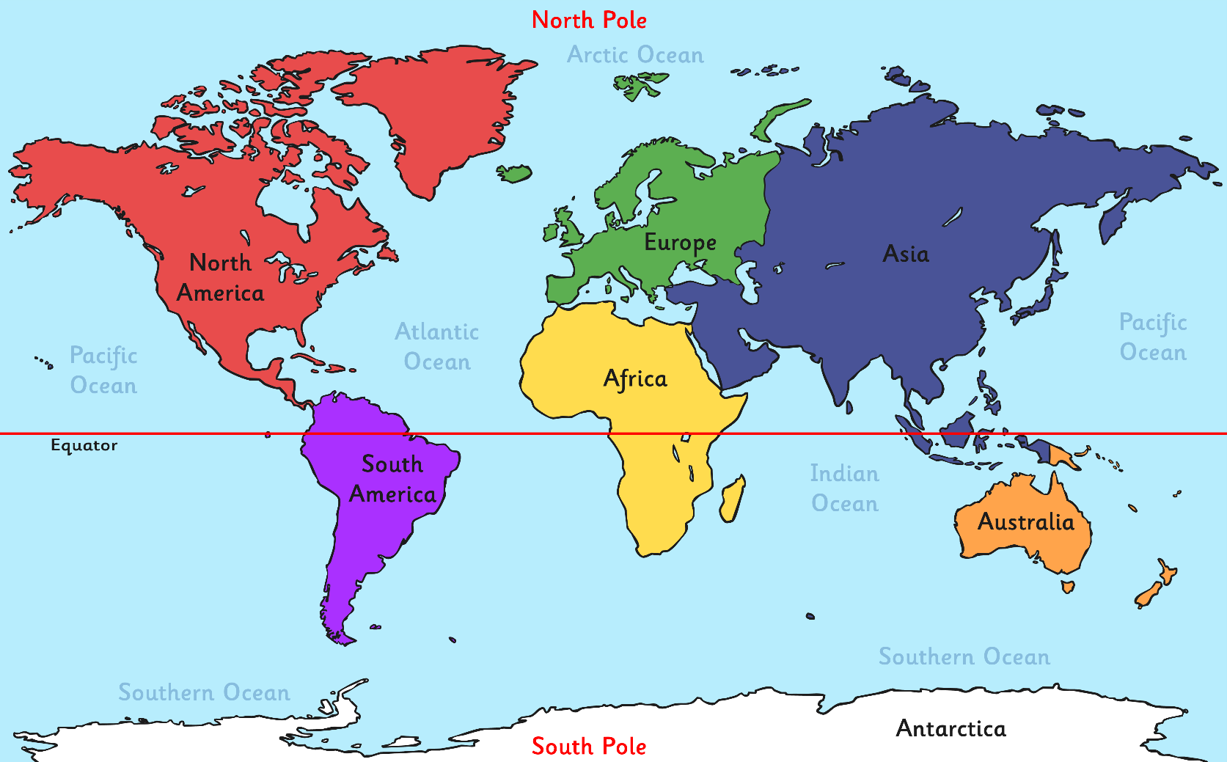
Where Is Kenya?
World map showing continent of Africa

Slide 5
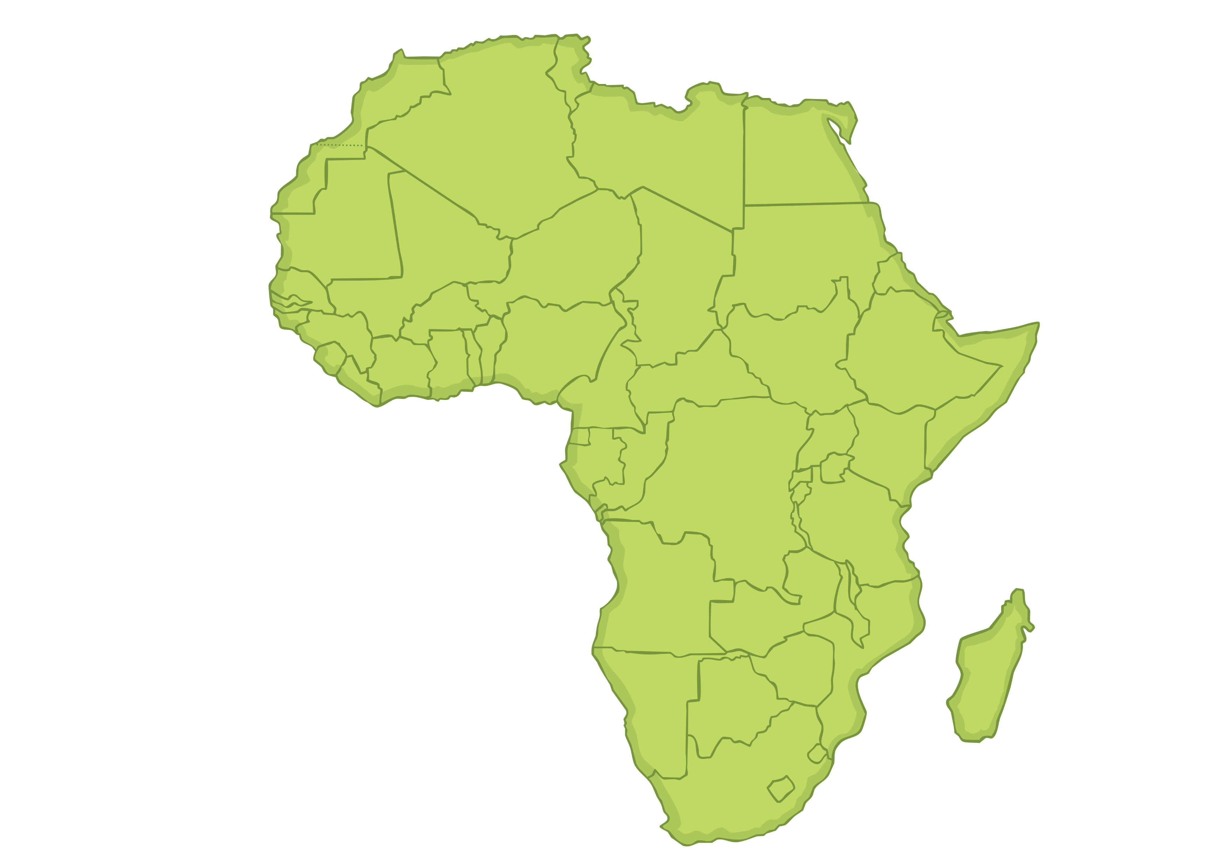
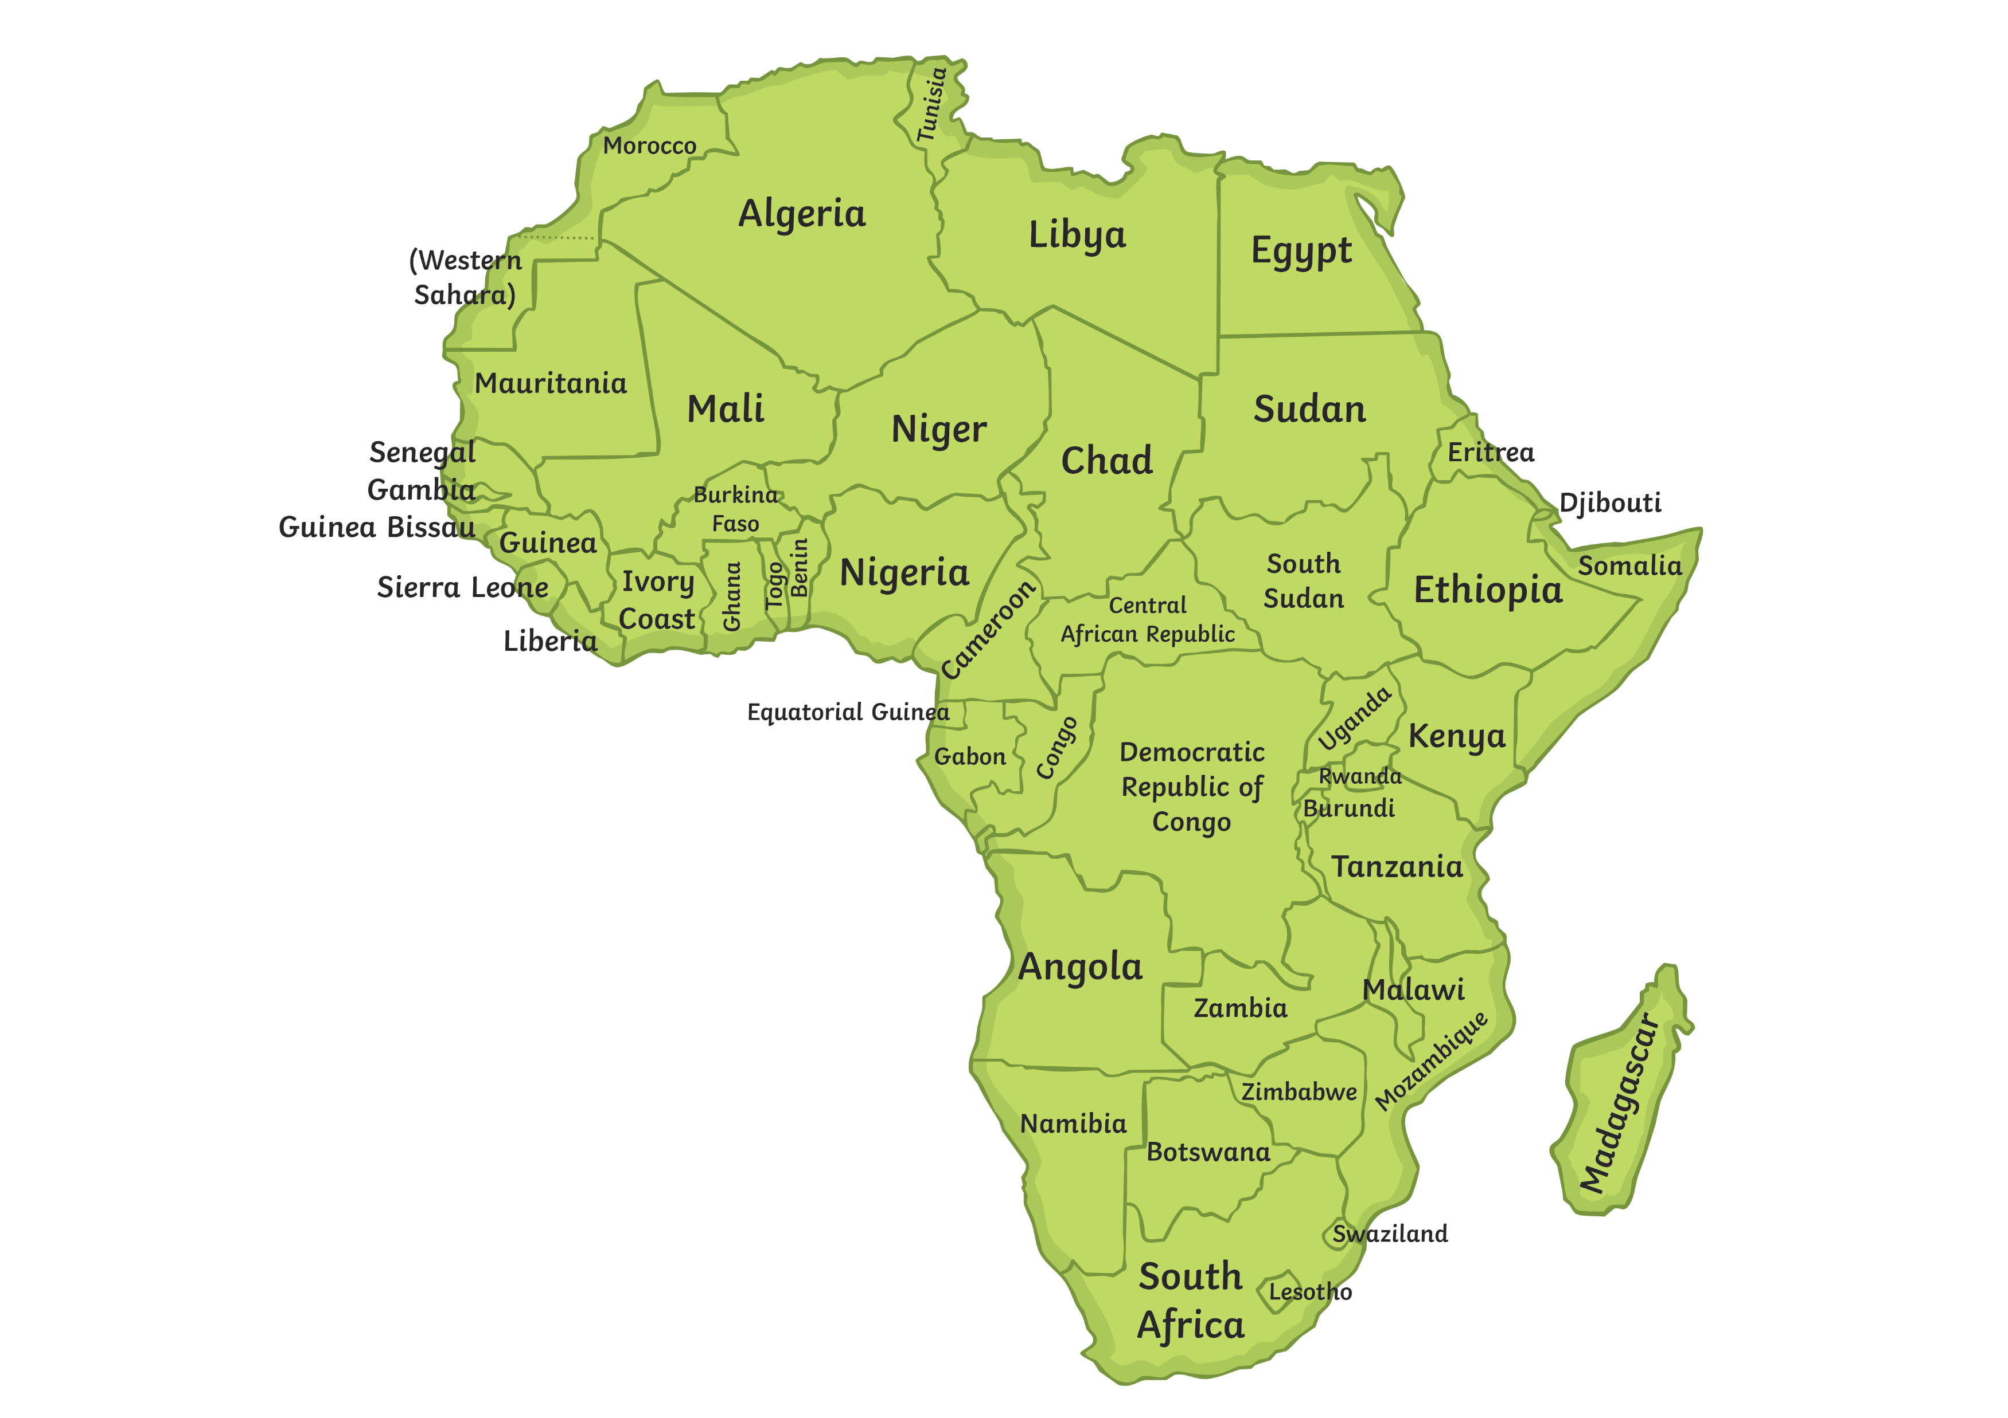
Where Is Kenya?

Slide 6

Where Is Kenya?

Slide 7
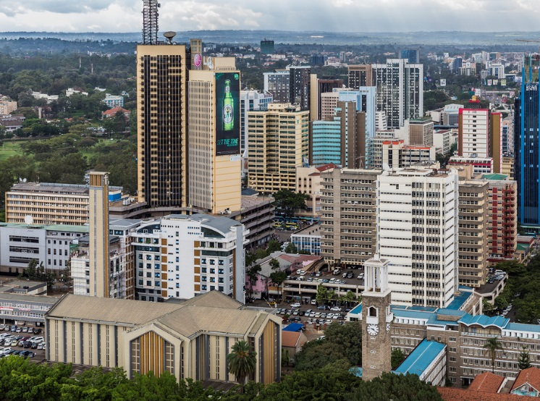
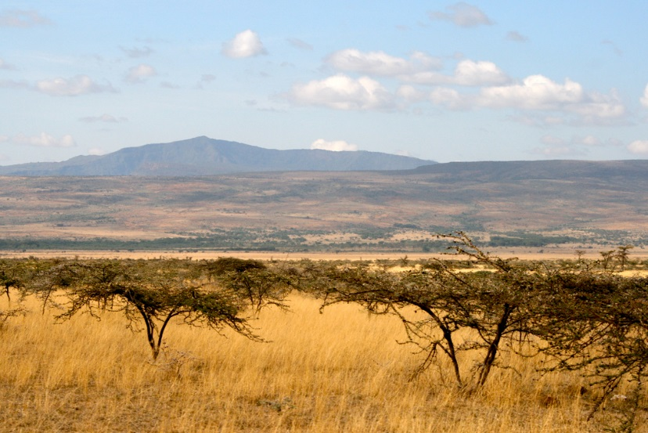
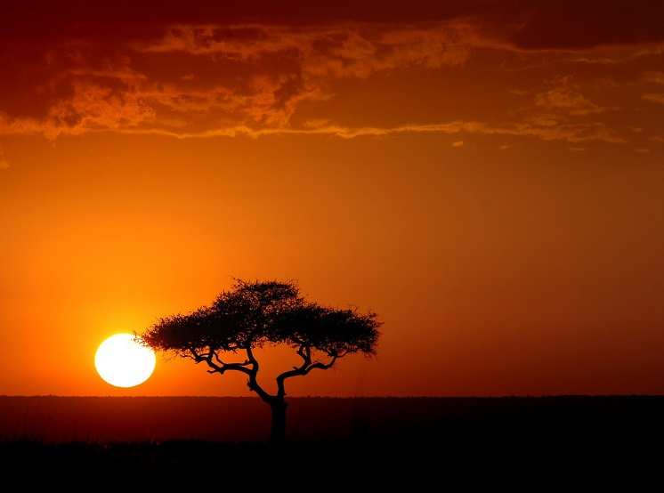
Where Is Kenya?
Kenya is located in East Africa. It is known as the Republic
of Kenya.
Kenya’s population is around
44 million! Kenya is one small country compared to the vast size of the continent, Africa.

Slide 8
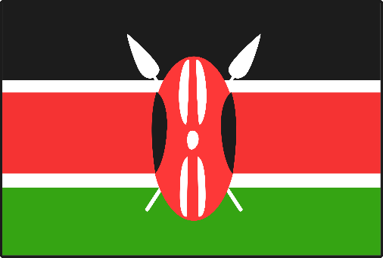
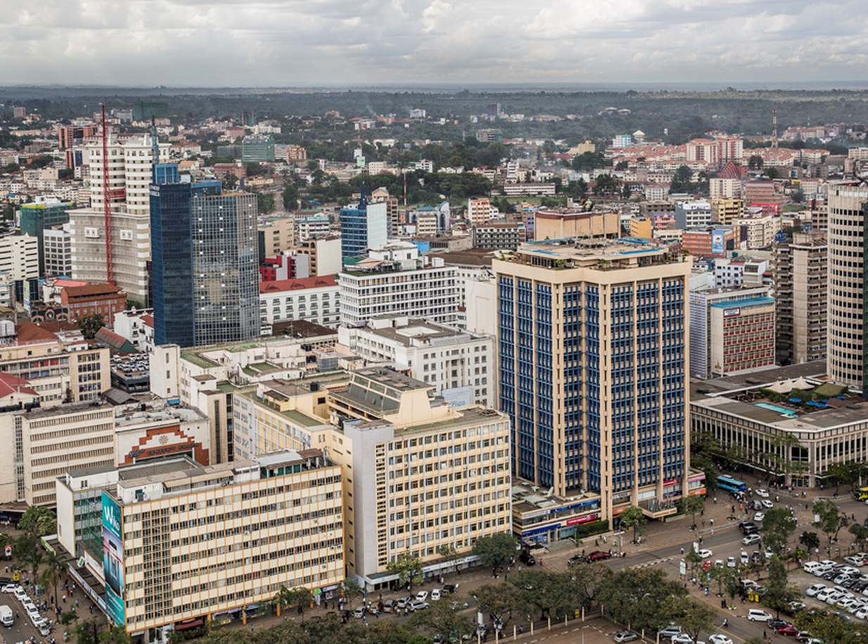
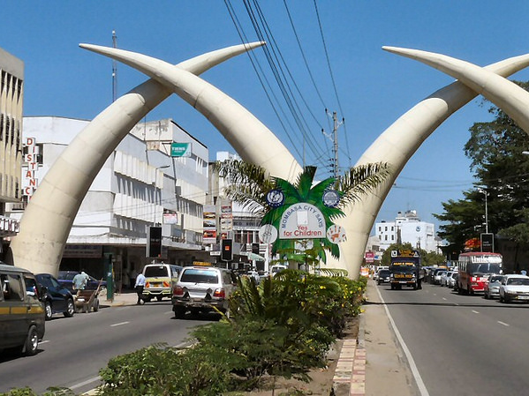
Where Is Kenya?
This is Kenya’s national flag:
Nairobi is the capital
city and Mombasa is the
largest city in Kenya.

Slide 9
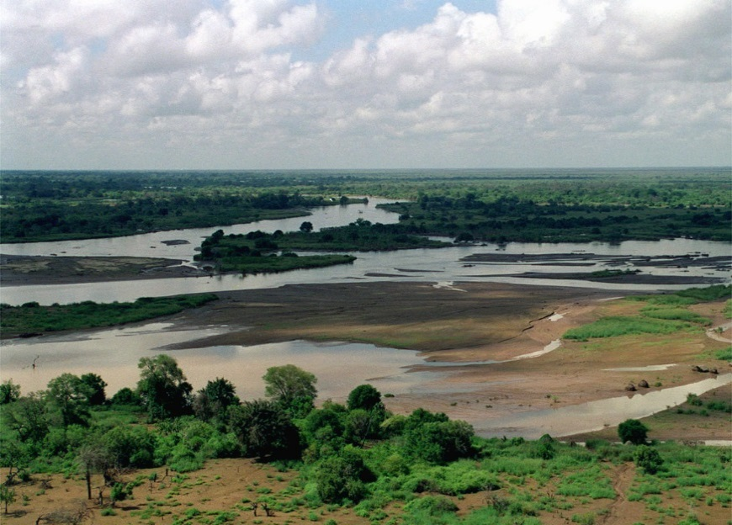
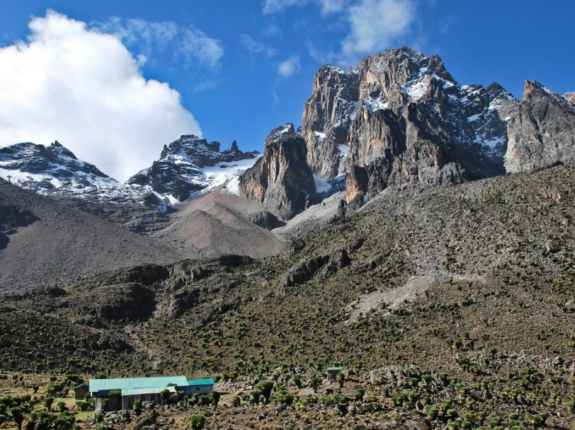
Where Is Kenya?
The Tana river is the longest river in Kenya.
Mount Kenya is the highest mountain in Kenya,
and the country itself was named after the mountain!

