Slide 2

Click the box to reveal the shape
?
Next shape
cube

Slide 3
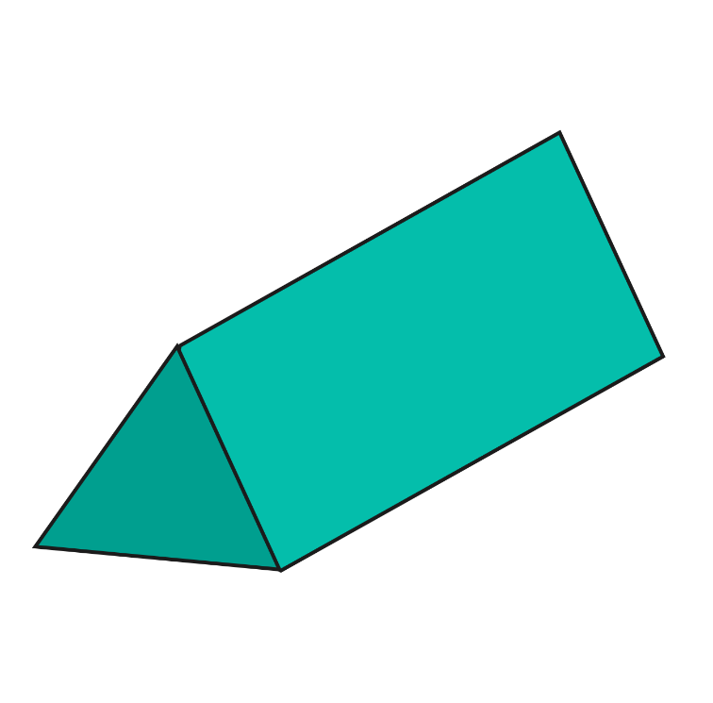
Click the box to reveal the shape
?
Next shape
triangular prism

Slide 4
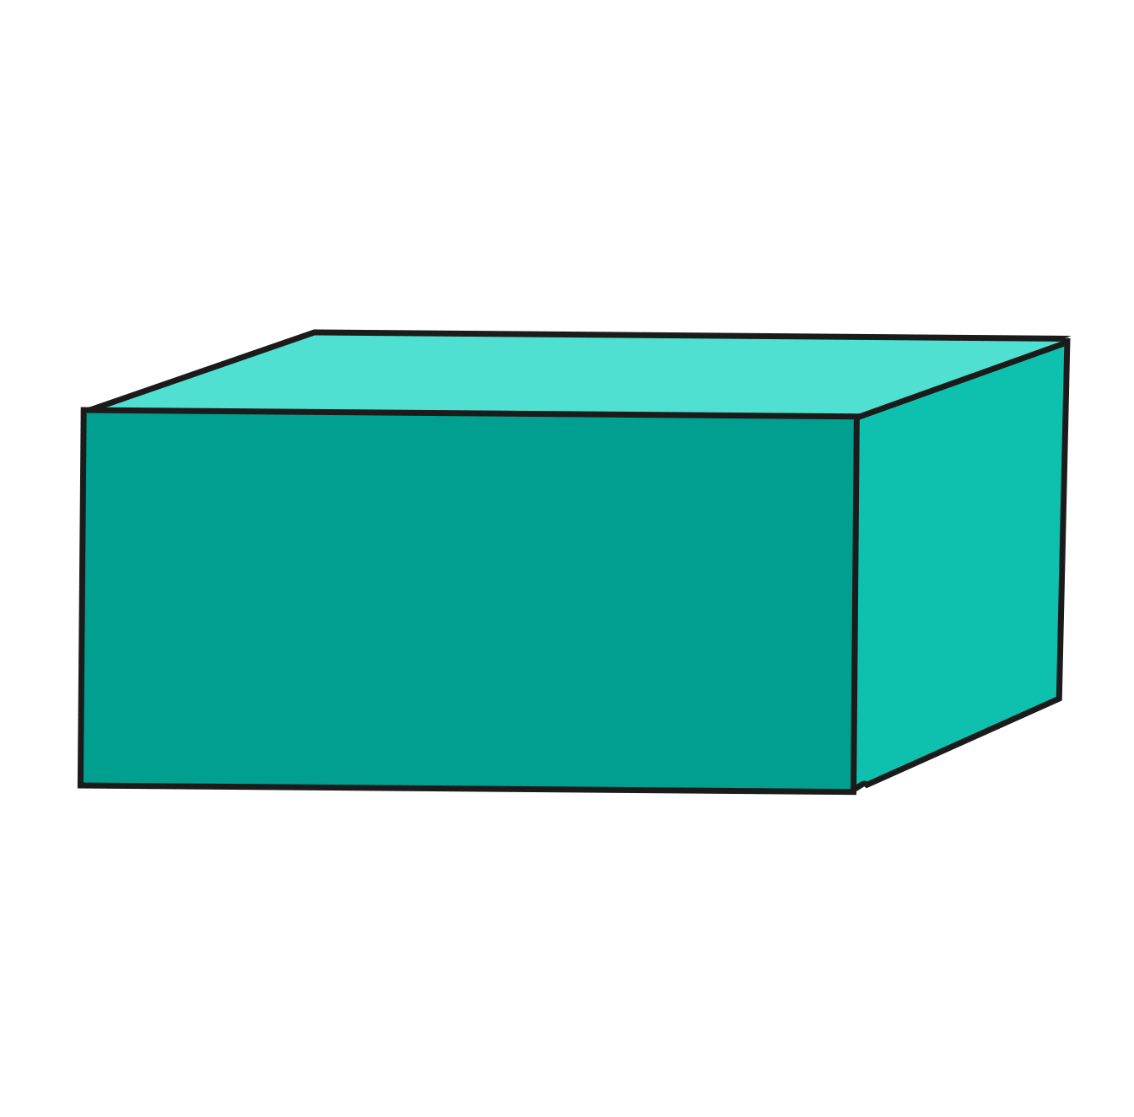
Click the box to reveal the shape
?
Next shape
cuboid

Slide 5

Click the box to reveal the shape
?
Next shape
cone

Slide 6
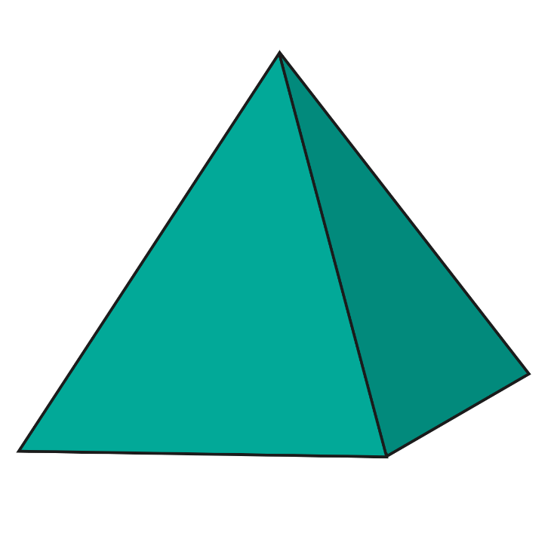
Click the box to reveal the shape
?
Next shape
pyramid

Slide 7

Click the box to reveal the shape
?
Next shape
cylinder

Slide 8

Click the box to reveal the shape
?
sphere

Slide 9
Shape challenge!
In this game the boxes will disappear to reveal a 3D shape. Can you be the first to guess which shape it is?
Play!

Slide 10

What is the shape?
Show me!
sphere

Slide 11
What is the shape?
Show me!
sphere

Slide 12
What is the shape?
Show me!
cuboid

Slide 13
What is the shape?
Show me!
cuboid

Slide 14

What is the shape?
Show me!
pyramid

Slide 15
What is the shape?
Show me!
pyramid

Slide 16

What is the shape?
Show me!
cylinder

Slide 17
What is the shape?
Show me!
cylinder

Slide 18

What is the shape?
Show me!
triangular prism

Slide 19
What is the shape?
Show me!
triangular prism

Slide 20

What is the shape?
Show me!
cube

Slide 21
What is the shape?
Show me!
cube

Slide 22

What is the shape?
Show me!
cone

Slide 23
What is the shape?
Show me!
cone

