Slide 1
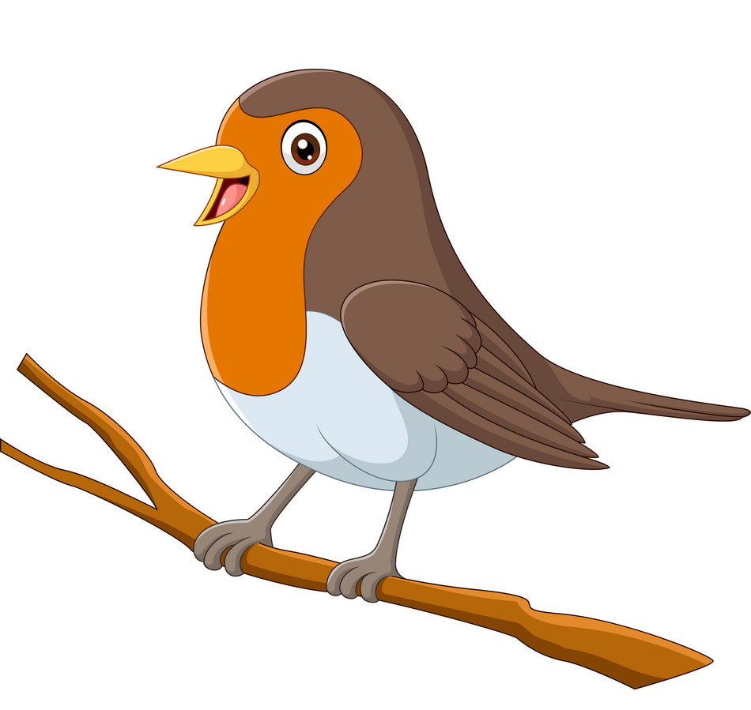
Curriculum Plan
Robins Class
Year B

Slide 2
Term 1 – Our Families
English
Recount – My Summer Holidays
Narrative – Based on A Tiger Who Came to Tea
Character Description – Based on We’re Going on a Bear Hunt
Geography
Families from Around the World
Computing
Online Safety
Maze Explorers
Art and design
Self Portrait (Picasso)
PSHE/SMSC
Relationships – Families
Health and Wellbeing – What makes us all special/ unique
Design and technology
Design a Family Crest
Maths
Number – Counting and Sequencing
Ordering Numbers
Place Value
Addition/ Subtraction
Odds and even
Reasoning to be intertwined within all aspects of mathematics
Music
Beethoven - Senses
PE
Swimming & Circuits
Focus Books
The Tiger Who Came to Tea
We’re Going on a Bear Hunt
Happy Families Series
RE
God (Christianity)
Languages
French – Family Members - Introduction with register
Science
Plants

Slide 3
Term 2 – The UK
English
Seasonal Poems
Setting Description – based on Katie Morag
Diary Entry – Katie Morag
Instructions – How to Brush your Teeth
Geography
Name and locate four countries and capital cities of the UK and surrounding seas
Human and Physical Geography
Aerial Photographs of London – Create own map/ simple key of Quadring Primary (Fieldwork of local area)
Use directions, locational and directional language to describe the location of features and routes on a map
Computing
Online Safety
Questioning
PSHE/SMSC
Health and Wellbeing – Dental Care
Maths
Multiplication and Division (by sharing)
Doubles
Money
Place Value
Shape
Reasoning to be intertwined within all aspects of mathematics
PE
Swimming & Basketball/ Handball
RE
Being Human (Christianity)
Art and design
UK landmarks - Sculptures
Christmas Art
Focus Books
The Katie Morag Treasury
The Polar Express
Science
Plants
One week focus on current season - Autumn (Seasonal change)
Music
Harvest & Nativity Songs

Slide 4
Term 3 – Africa
English
Postcard – from Afrcia
Review – based on African D&T
Information Poster – Escaped African Animals
Narrative – Based on Handa’s Surprise
History
Nelson Mandela
Computing
Online Safety
Animated Story Books
Making music
Geography
Similarities and Differences between Quadring & Kenya (Maps/Atlas/Globes)
PSHE/SMSC
Health and Wellbeing - Feelings
Maths
Shape including Position and Direction
Fractions of shapes and numbers
Statistics
Reasoning to be intertwined within all aspects of mathematics
Art and design
African Patterns using a range of skills
Shape animals
PE
Dance
Design and technology
Maasai Collar
Maasai Mud Hut
RE
Community (Christianity)
Science
Living Things and Their Habitats
One week focus on current season – Winter (Seasonal change)
Focus Books
Handa’s Surprise
Handa’s Hen
Music
African Drumming

Slide 5
Term 4 – Africa
English
Setting Description – Africa
Creative Writing with Rhyme – based on The Ugly Five
Geography
African Landmarks
Computing
Online Safety
Spreadsheets
Art and design
African Landscape – Safari - Layering
PSHE/SMSC
Relationships – Friendships
Relationships – Respecting self and others
Maths
Addition and Subtraction
Place Value – More and Less than
Division
Inverse Operations – Addition and Subtraction
Rounding and Estimating
Reasoning to be intertwined within all aspects of mathematics
Design and technology
Design African Drum (Link to Music)
PE
Tri-Golf
Music
Home-Made African Instruments
RE
Life Journey (Christianity)
Focus Books
The Ugly Five
Science
Living Things and Their Habitats
One week focus on current season - Spring (Seasonal change)

Slide 6
Term 5 – Ship Ahoy! (America)
English
Instructions
Narrative – based on Supertato
Non-Chronoligal Report – Sharks
Biography – Matthew Flinders
History
Matthew Flinders
Sir Joseph Banks
Computing
Online Safety
Pictograms
Geography
Name and Locate Seven Continents and Five Oceans
PSHE/SMSC
Health and Wellbeing – Keeping Safe
Maths
Time
Measure – Length, Mass and Capacity
Inverse Operations – Multiplication and Division
Reasoning to be intertwined within all aspects of mathematics
PE
Uni-Hok & Sports Evening Practice
Art and design
J.M.W. Turner - Seascapes
RE
Places of Worship
Design and technology
Design way to get a Ship into the sea
Focus Books
Supertato
A Cat Called Trim
Captain Pugwash
Science
Animals including Humans
Music
Sea Shanties

Slide 7
Term 6 – Fire!
English
Fire Safety Poster
Diary (Samuel Pepys)
Eye Witness Account – The Great Fire of London
Newspaper report/ TV report – Traditional Tales & The Great Fire of London
History
Events Beyond living Memory – The Great Fire of London
Computing
Online Safety
Presenting Ideas
Geography
Maps of London – 1666/ Present Day
PSHE/SMSC
Fire Safety
Health and Wellbeing – People Who Help Us
Living in the Wider World – Jobs
Health and Wellbeing – New Year/Class
Art and design
The Great Fire of London - Landscape
Maths
Addition
Subtraction
Multiplication
Division
Reasoning to be intertwined within all aspects of mathematics
Design and technology
Make Tudor House
Cooking
PE
Cricket & Sports Evening Practice
RE
Places of Worship
Music
Fire hand percussion – different dimensions of music to create hand choir
London’s Burning (Round)
Science
Animals including Humans
One week focus on current season - Summer (Seasonal change)
Focus Books
The gingerbread Man
Three Billy Goats Gruff
The Great Fire of London

