Slide 1
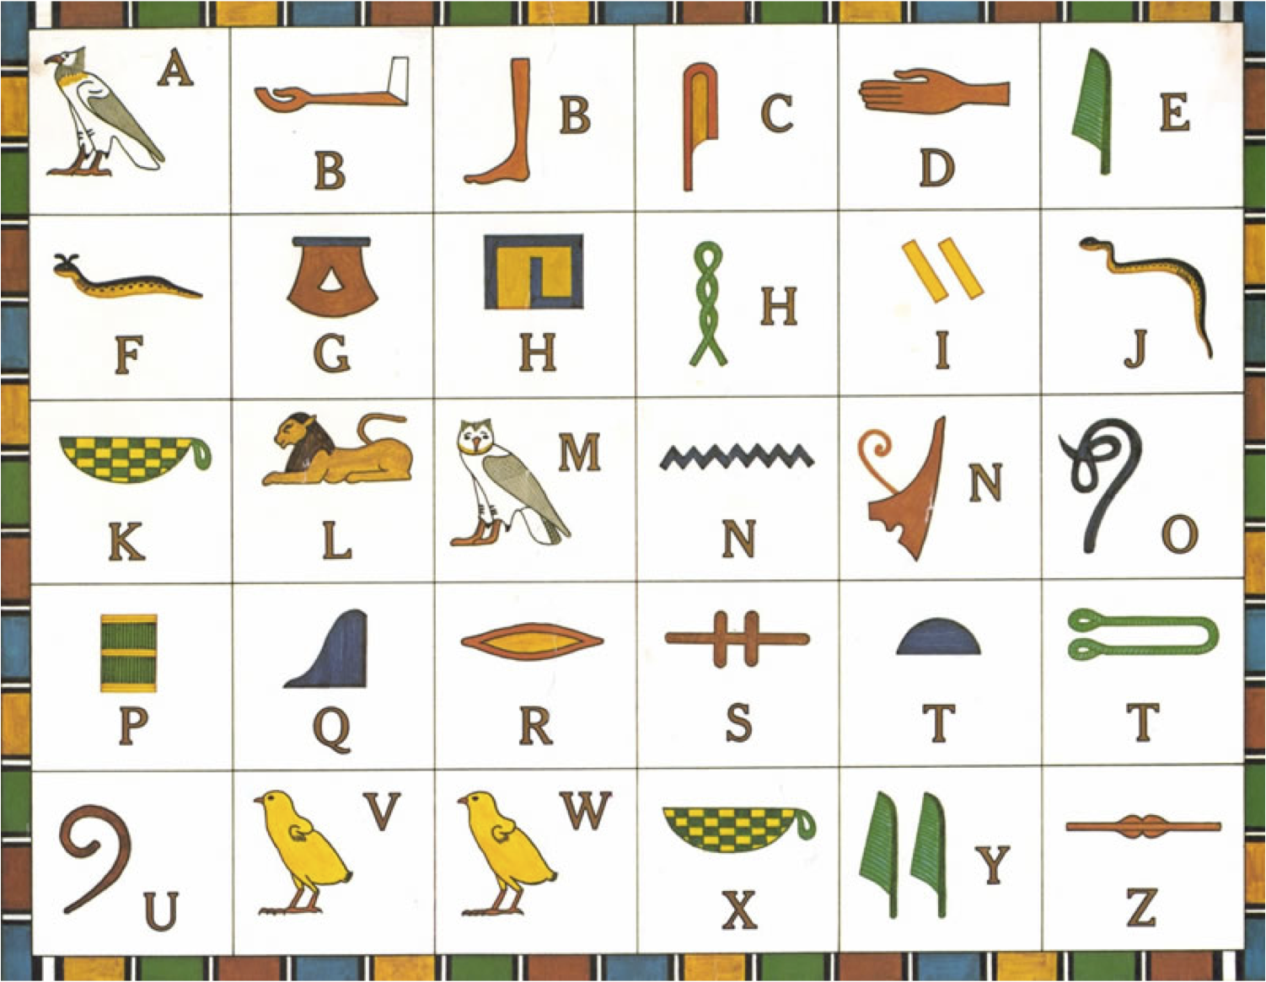
Hieroglyphics CVC Quiz
Use the Egyptian alphabet to help you work out the following CVC words made from pictures.

Slide 2



d
o
g

Slide 3


Slide 4


z
i
p

Slide 5
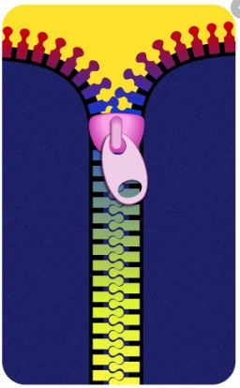

Slide 6


n
e
t

Slide 7


Slide 8


v
a
n

Slide 9


Slide 10



b
u
s

Slide 11


Slide 12

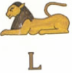




Now have a go at drawing your name in Heiroglyphics.

