Slide 1
Coin Caterpillars
2p
1p
1p
1p
2p

Slide 2
How much is this caterpillar
worth?
Remember to “tap the coins.”
5p
1p
1p
1p
1p
1p

Slide 3
How much is this caterpillar
worth?
Remember to “tap the coins.”
7p
1p
1p
1p
1p
1p
1p
1p

Slide 4
How much is this caterpillar
worth?
Remember to “tap the coins.”
4p
1p
2p
1p

Slide 5
How much is this caterpillar
worth?
Remember to “tap the coins.”
6p
1p
1p
1p
1p
2p

Slide 6
How much is this caterpillar
worth?
Remember to “tap the coins.”
7p
2p
1p
1p
1p
2p

Slide 7
How much is this caterpillar
worth?
Remember to “tap the coins.”
2p
9p
2p
1p
1p
1p
2p

Slide 8
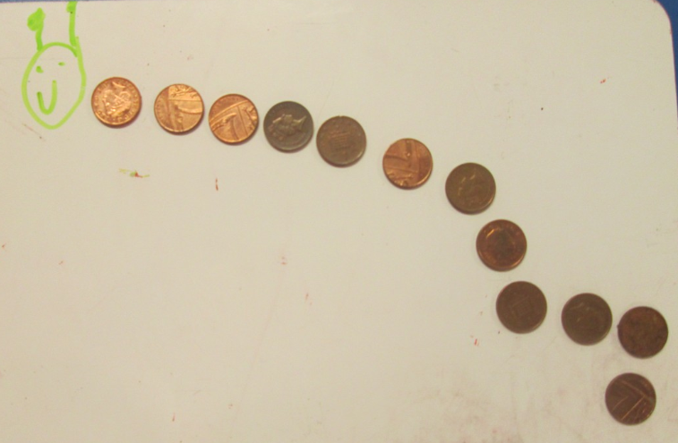
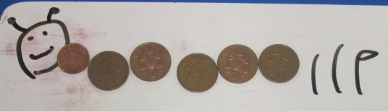
Have a go at creating your own coin caterpillars.
Draw around the 1p and 2p coins you have at home.
Maybe your adult could give you a total,
and you can create the coin caterpillar for it –
using your 1p and 2p coins. Like these below:
12p

