Slide 1

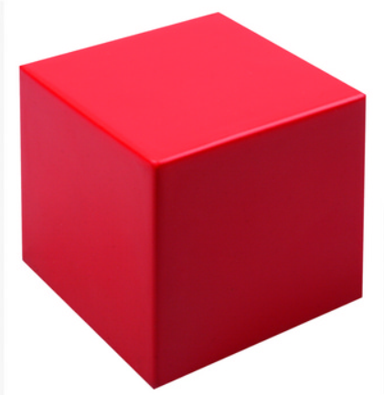
2D vs 3D shapes
Sphere and Cube

Slide 2
A 2D shape is “flat.”
When describing a 2D shape we say they have sides and corners.

Slide 3
I’m thinking of a 2D shape.
It has no corners.
It has one curved side.
It’s a…
circle

Slide 4
I’m thinking of a 2D shape.
It has 4 corners.
It has 4 straight sides.
All the sides, are the same length.
It’s a…
square

Slide 5
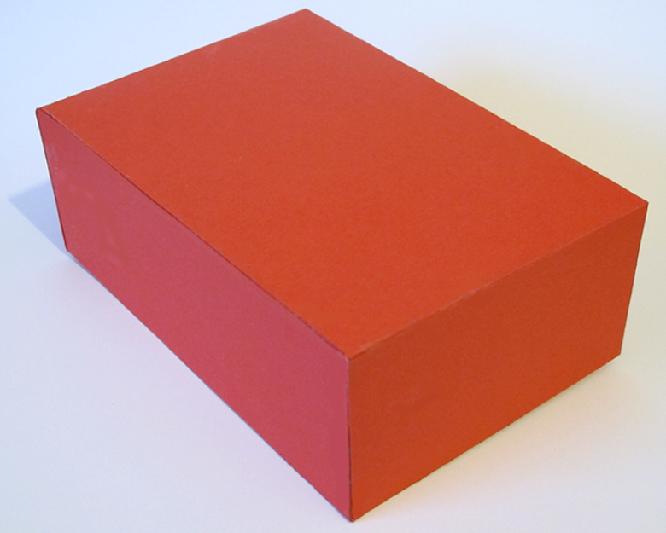
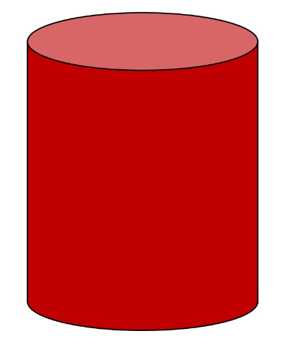
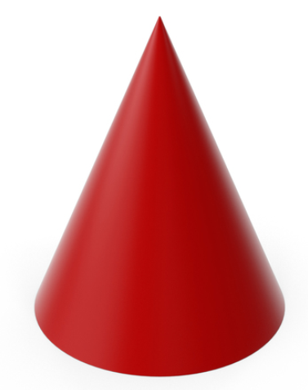
We also have shapes that are 3D.
This means they are not “flat!”
This means they are “like a block.”

Slide 6
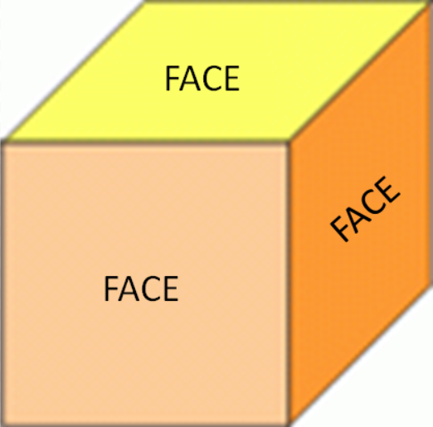
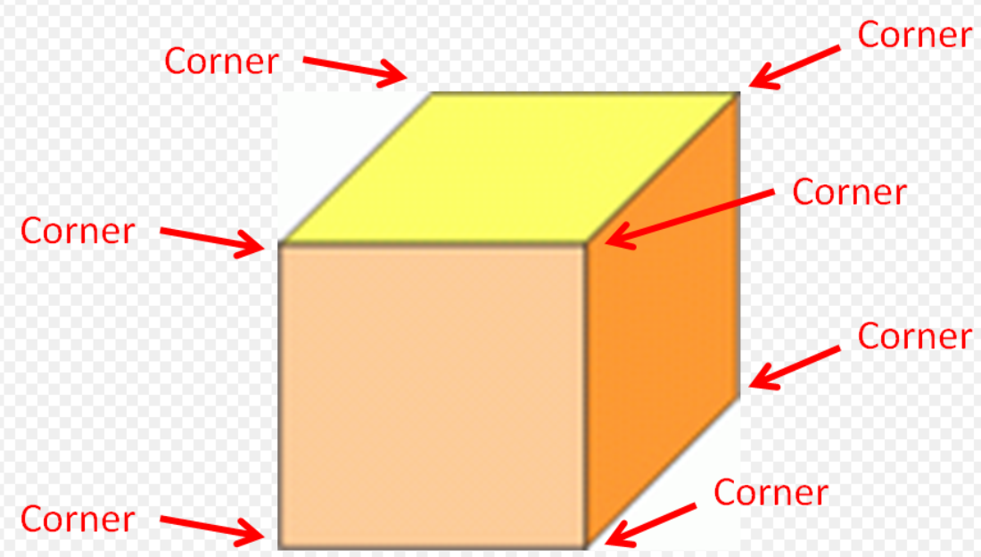
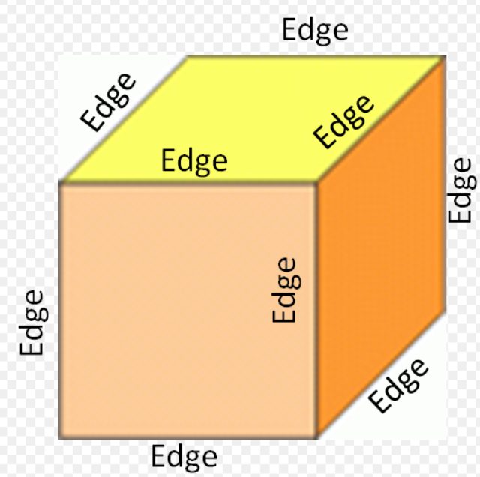
When describing a 3D shape, we use the words:
Faces
Corners
Edges

Slide 7
This 3D shape is a
Sphere

Slide 8
It has 1 curved face.
It has 0 corners

Slide 9
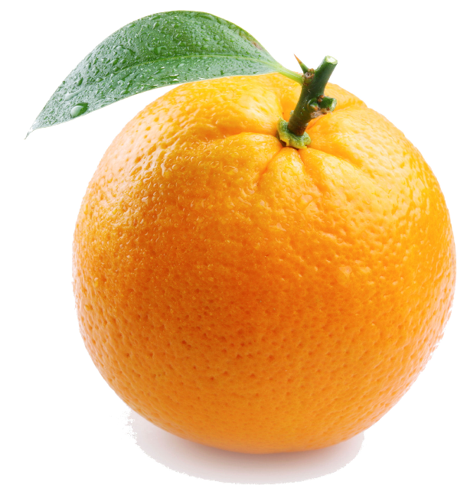
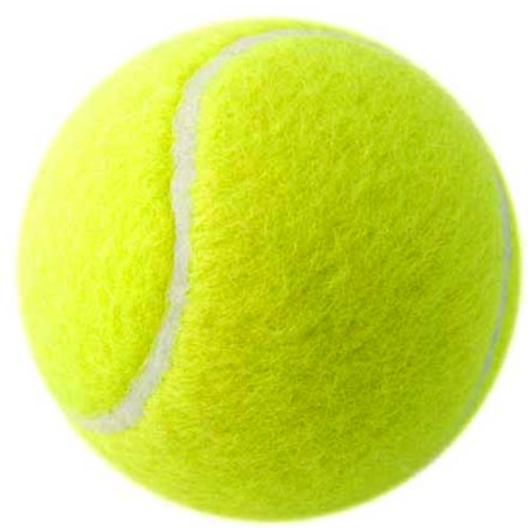

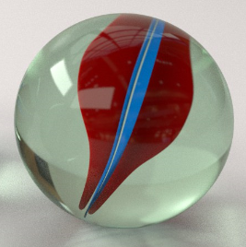
The following objects are all
Spheres

Slide 10
This 3D shape is a
Cube

Slide 11
It has 6 square faces.
It has 8 corners

Slide 12


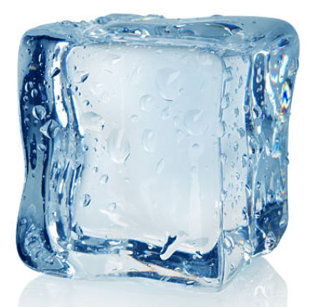
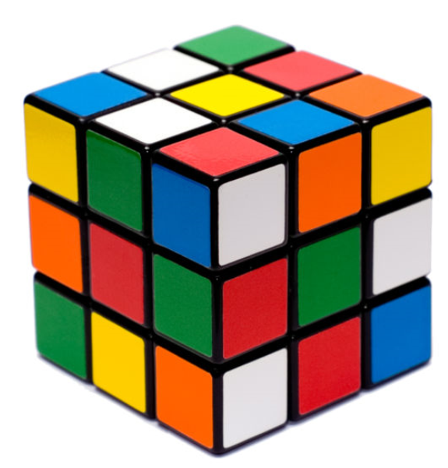
The following objects are all
Cubes

Slide 13
Today we have learnt…
Sphere
Cube

