Slide 1
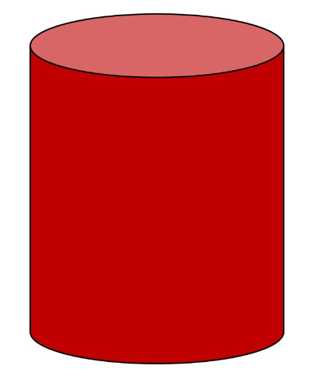
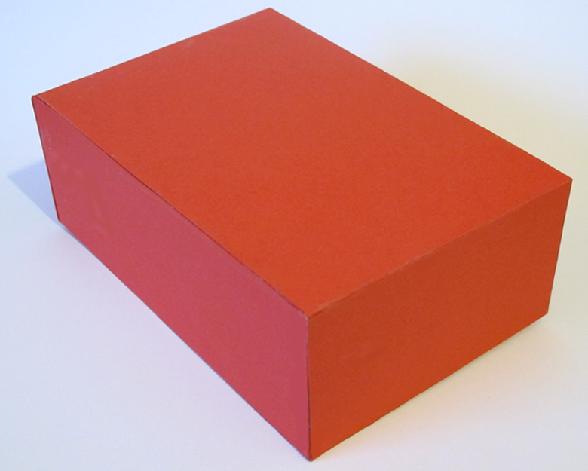
3D shapes
Cylinder and Cuboid

Slide 2
A 2D shape is “flat.”
When describing a 2D shape we say they have sides and corners.

Slide 3

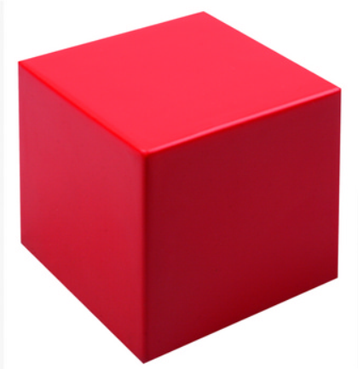
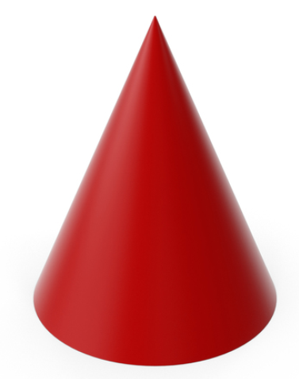
We also have shapes that are 3D.
This means they are not “flat!”
This means they are “like a block.”

Slide 4
This 3D shape is a
Cylinder

Slide 5
It has 1 curved face.
It has a circle face on each end.
It has 0 corners.

Slide 6
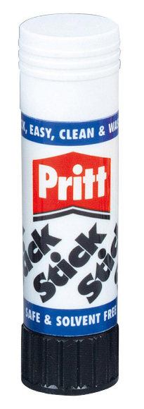
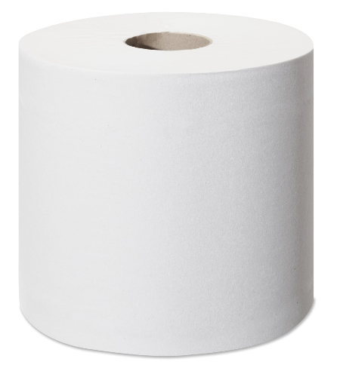
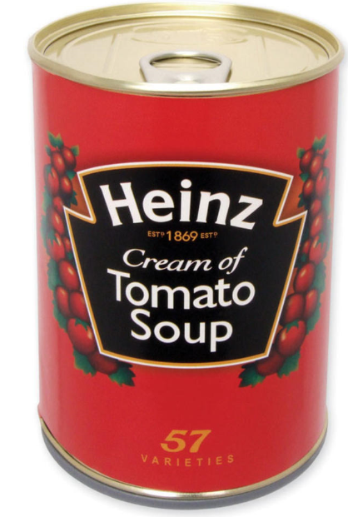
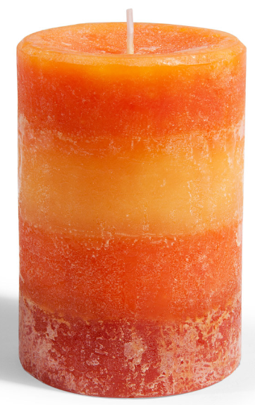
The following objects are all
Cylinders

Slide 7
This 3D shape is a
Cuboid

Slide 8
It has 6 faces.
It has 8 corners

Slide 9
It can have 6 faces that are all rectangles.

Slide 10
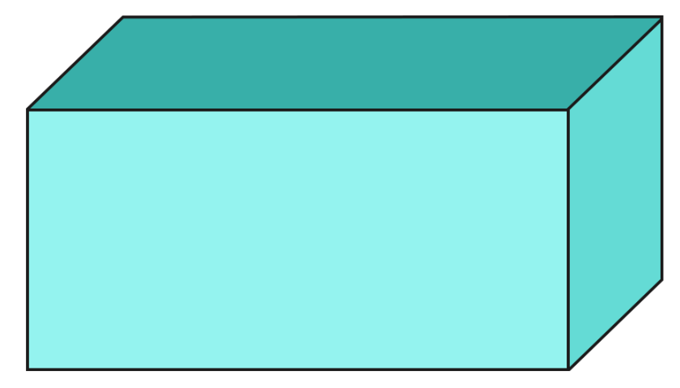
It can also have 4 faces that are rectangles and a square face on each end.

Slide 11
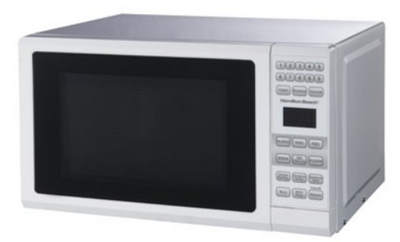
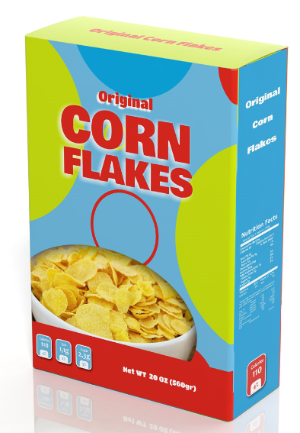
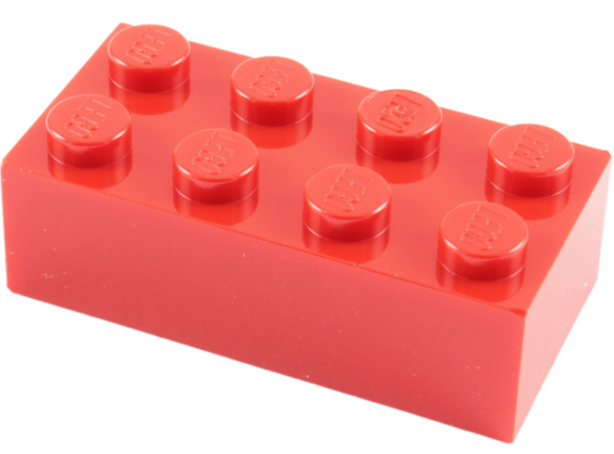

The following objects are all
Cuboids

Slide 12
Today we have learnt…
Cylinder
Cuboid

