Slide 1
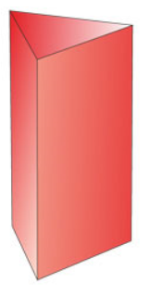
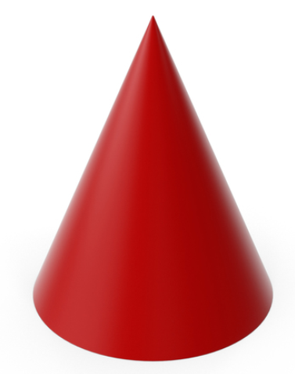
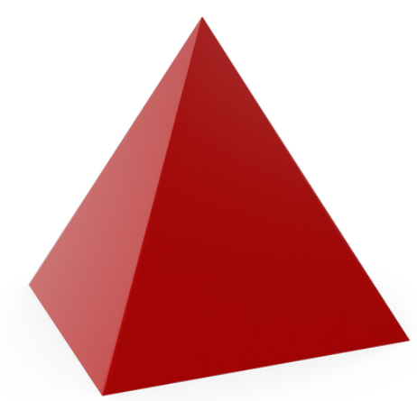
3D shapes
Cone, Pyramid and Prism

Slide 2
A 2D shape is “flat.”
When describing a 2D shape we say they have sides and corners.

Slide 3

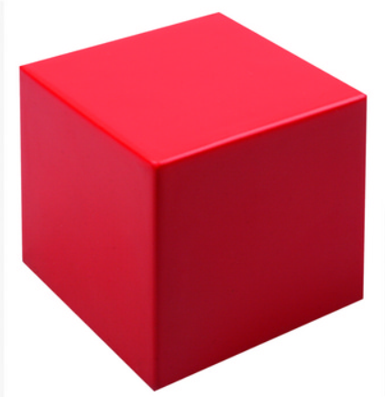
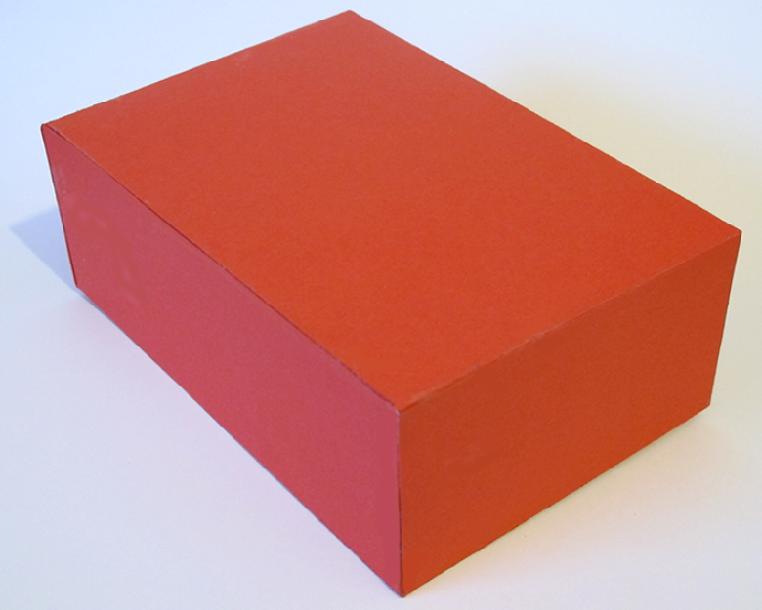
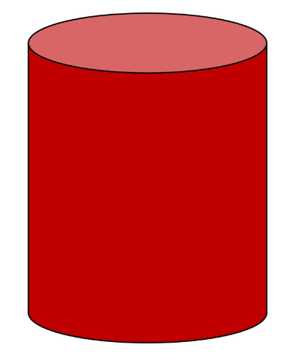
We also have shapes that are 3D.
This means they are not “flat!”
This means they are “like a block.”

Slide 4
This 3D shape is a
Cone

Slide 5
It has 1 curved face.
It has 1 circle face at one end.
It has 1 point.

Slide 6


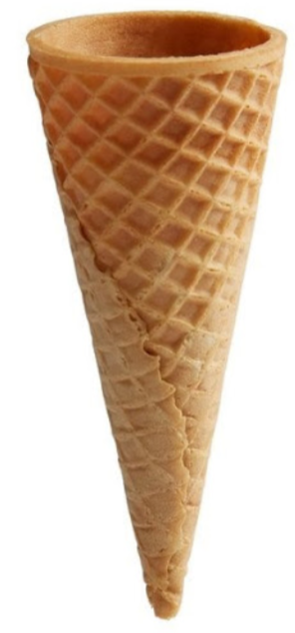
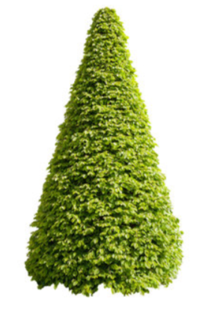
The following objects are all
Cones

Slide 7
This 3D shape is a
Pyramid

Slide 8
It has 5 faces.
It has 4 corners and 1 point.

Slide 9
It can have 4 triangle faces and
1 square base.

Slide 10
Or it can have 3 triangle faces and 1 triangle base.

Slide 11
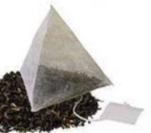
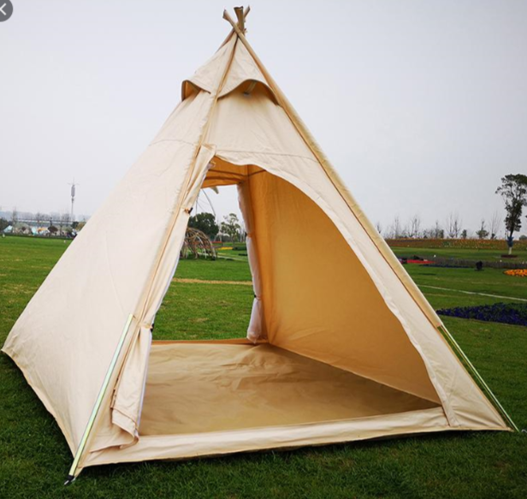
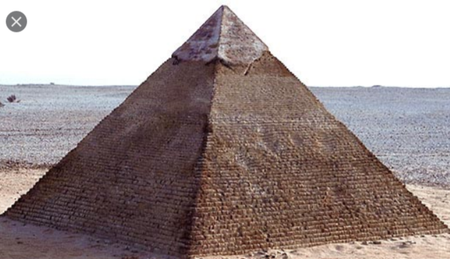
The following objects are all
Pyramids

Slide 12
This 3D shape is a
Triangular Prism

Slide 13
It has 3 rectangle faces.
It has 2 triangle faces,
1 at each end.

Slide 14
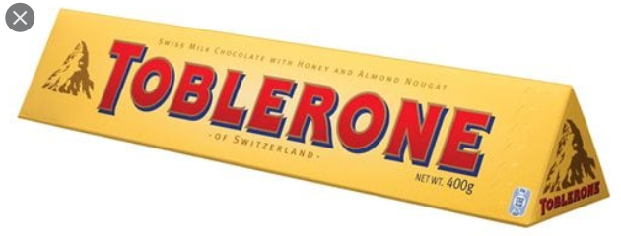

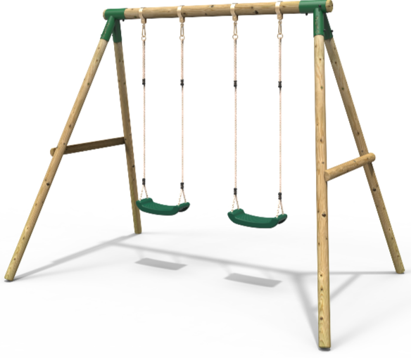
The following objects are all
Triangular Prisms

Slide 15
Today we have learnt…
Cone
Pyramid
Prism

